Slide 1
PYTHON PROGRAMMING FOR GPUs
Kristopher Keipert
kkeipert@nvidia.com

Slide 2
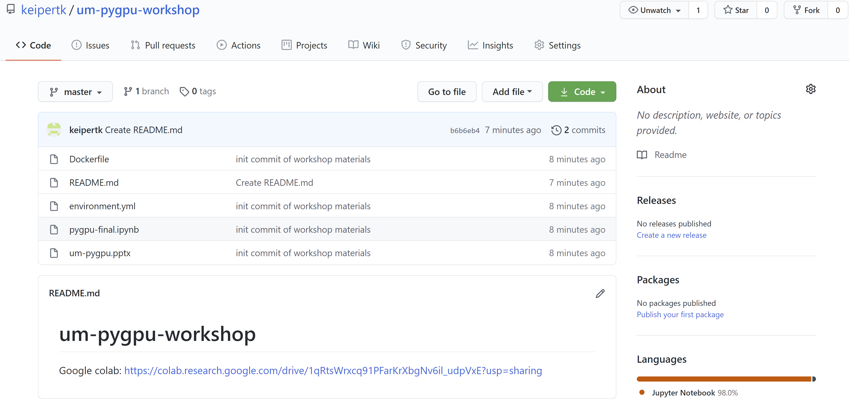
Slides and Notebook:
https://github.com/keipertk/pygpu-workshop

Slide 3
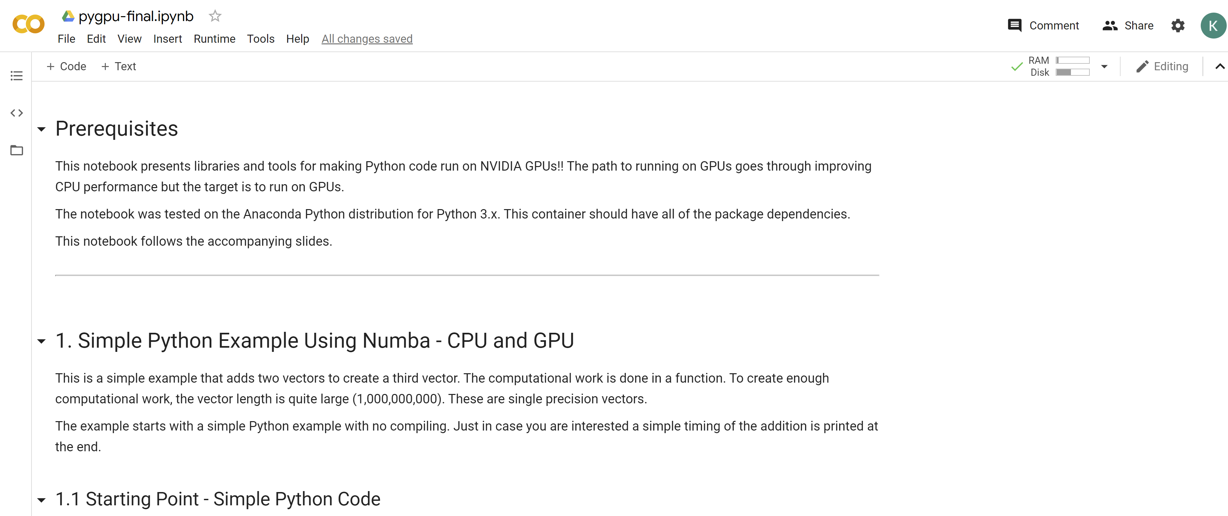

Slide 4
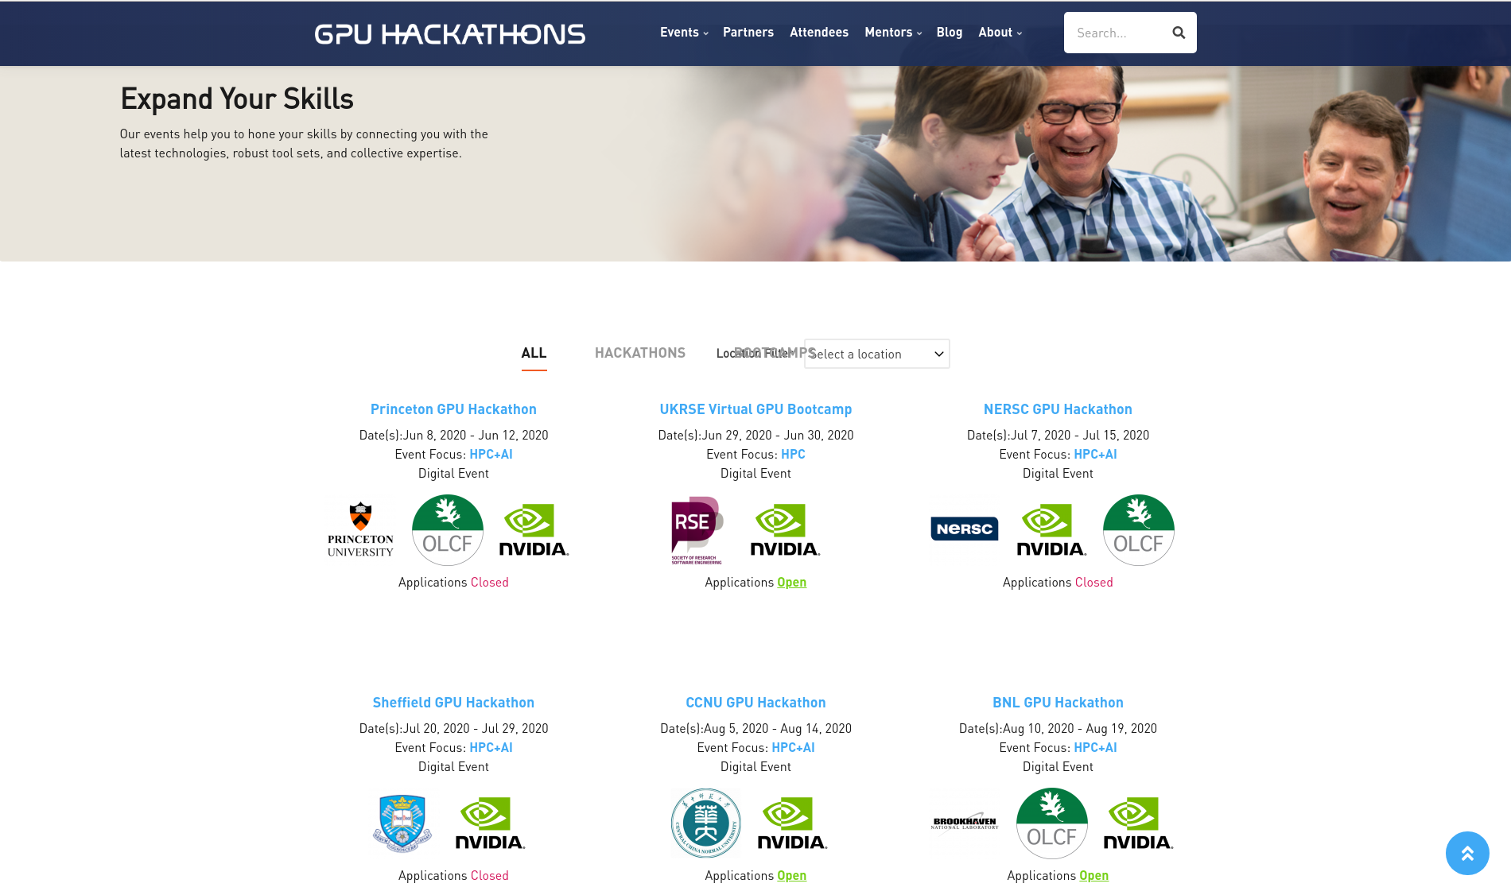
gpuhackathons.org

Slide 5
GPU Programming questions?
kkeipert@nvidia.com
Python GPU Programming
CUDA C/C++/Fortran
GPU Porting Strategy
Performance Profiling and Developer Tools

Slide 6
Agenda
Why Python?
Python Coding for GPUs
Numba (JIT compiler)
CPU and GPU Decorators
Compiling ahead of time
Example of serial->GPU porting process
GPU functions calling GPU functions
CuPy – GPU Enabled Numpy
Moving data to/from GPUs
Dask integration (if time permits)

Slide 7
Python coding for GPUs

Slide 8
Why Python?
Very popular in many fields
Scientific community is quickly adopting Python, especially for data analytics
#1 language for Deep Learning
Features:
High-level, interactive, versatile (Jupyter Notebooks)
Easy to prototype
Can expose bindings for lower-level languages (PyBind11, cppyy)
Automatic Memory Management + Garbage collection (reclaim memory from deleted variables)
Dynamic typing (Runtime type checks)
Wide range of data types and structures (intrinsic Complex and Boolean data types)
Many libraries (modules) available
Robust package and environment management (conda, pip)

Slide 9
Why Python?
And GPUs?
Easy to use
You don’t have to learn CUDA! (CUDA-less GPU programming)
Unless you really want to ☺
Performance
High-level scripting languages are in many ways' polar-opposite to GPUs
GPUs are highly parallel, designed for maximum throughput, and they offer a tremendous advance in performance
Scripting languages such as Python favor ease of use over computational speed and do not generally emphasize parallelism
Numba and CuPy
Notes:
Learning CUDA can be a long and difficult process. You need to know C and C++ ahead of time (Python and C/C++ are generally orthogonal to each other).
This lecture discusses using GPUs without having to learn CUDA (although using bits of CUDA with Python will be presented).
For many years there was no standard on using Python with GPUs. Each library or tool stood on its own. With the development of RAPIDs we now have a standard, cuDF, built on Apacje Arrow. Now we can have tools interoperate (example, Numba and CuPy).

Slide 10
TL;DR - OVERALL PYTHON CODING RECOMMENDATIONS
Make sure you have a relevant test suite
Unit tests helpful for detecting where the problem is when extending for GPU
End-to-end tests also helpful - need to be aware of numerical sensitivities
Benchmarks: good to measure wall time before / during / after your porting efforts
First of all, profile the code and make sure you understand where you need better performance.
Python Profiling Tools:
Snakeviz
cProfile + gprof2dot
Line_profiler

Slide 11
TL;DR - OVERALL Python-GPU CODING recommendations
These apply to any language coding for GPU, but are especially important for Python
Avoid data movement to/from GPU and CPU
Do as much as you can on the GPU
“What happens on the GPU, stays on the GPU”
Look for loops and arrays to achieve performance improvements
GEMMs!
Don’t port string handling or integer computations to the GPU
Avoid divergence and complex logic branching (GPU is SIMT)
When “porting” to GPU, intermediate code can be slower than CPUs
Don’t be surprised, don’t give up – profile!
Giving the GPU enough work to amortize data movement?
"Locality is efficiency,
Efficiency is power,
Power is performance,
Performance is king"
-Bill Dally

Slide 12
NUMBA

Slide 13
Directives
Compiled Languages
Language “Directives” tell compilers about the code and how to build for target architecture (descriptive)
Let compilers and runtime do the work for us
They appear as “comments” so if the compiler doesn’t understand the pragma, it is ignored
OpenMP, OpenACC for Fortran and C/C++
#pragma acc parallel
{
#pragma acc loop
for(int i= 0; j < N; i++) {
a[i] = 0;
}
}
==============================================
!$acc parallel
!$acc loop
do i= 1, N
a(i) = 0
end do
!$acc end parallel

Slide 14
Directives and The JIT
JIT Compiler
Language “Directives” tell compilers about the code and how to build it for a target architecture (descriptive)
Python is designed to be an interpreted language
No compilation or static typing
“Interactive”
JIT = “Just in Time” Compiler
Compiles or creates object code “on the fly”
Combines interactivity and compilation
Allows for computationally intensive sections of Python code to be run on GPU (or multi-core CPU)

Slide 15
NUMBA
Introduction
Numba is a just-in-time (JIT), type-specializing, function compiler for accelerating numerically-focused Python
It has a numerical focus
Type-specializing
Numba generates a specialized implementation for the specific data types you are using or specifying
Python functions are designed to operate on generic data types
Typically, you only will call a function with a small number of argument types (simple functions)
Allows Numba to generate fast implementation for each set of types
Not every Python function can be compiled (subset of Python and NumPy)
Async features, class definitions, set/dict/generater comprehensions, generator delegation
Look for functions with high arithmetic intensity (e.g. chunky loops)

Slide 16
NUMBA
Decorators
Typically enabled by applying a decorator to a Python function
By definition, a decorator is a function that takes another function and extends the behavior of the latter function without explicitly modifying it
Functions that transform Python functions
Decorators used in this workshop:
@jit
@cuda.jit
@vectorize

Slide 17
NUMBA
More information
Numba runs inside the standard Python interpreter
Can target the CPU, either single-core or multiple-cores, or GPU
Uses LLVM to compile Python functions (comes with Numba)
The first time the function is called, the compiler creates a machine code implementation for inputs
Saves the original python implementation as .py_func
Can test compiled function against original Python function
Subsequent calls to function use machine code (much faster)
You can create compiled code prior to running
Data Types (dtypes):
bool_, int8, int16, int32, int64, uint8, uint16, uint32, uint64, float16, float32, float64, numpy.complex64, numpy.complex128

Slide 18
NUMBA
Universal Functions
NumPy has the concept of universal functions ("ufuncs")
Functions that can take Numpy arrays of varying dimensions (ndarray) and operate on them element-by-element (loop)
Perfect for processing on GPUs!
Numba can create compiled ufuncs
This is not easy to do by hand
Numba makes it easy for us
Write ufuncs to operate on scalars
Numba generates the surrounding loop/kernel

Slide 19
Example 1:
Simple Python Example for CPU

Slide 20
Base Python
import numpy as np
from time import perf_counter
def Add(a, b):
return a + b
# end def
# Initialize arrays
N = 10000
A = np.ones(N, dtype=np.float32)
B = np.ones(A.shape, dtype=A.dtype)
C = np.empty_like(A, dtype=A.dtype)
# Add arrays on CPU
start_time = perf_counter()
C = Add(A, B)
stop_time = perf_counter()
print(C)
print('')
print(' Elapsed wall clock time = %g seconds.' % (stop_time - start_time) )
print('')
1.1
Simple vector addition
Contains one function that does virtually all of the computation
This is our starting point

Slide 21
@JIT Example (Single Core)
import numpy as np
from time import perf_counter
from numba import jit
@jit
def Add(a, b):
return a + b
# end def
# Initialize arrays
N = 1000000000
A = np.ones(N, dtype=np.float32)
B = np.ones(A.shape, dtype=A.dtype)
C = np.empty_like(A, dtype=A.dtype)
# Add arrays on CPU
start_time = perf_counter( )
C = Add(A, B)
stop_time = perf_counter( )
print(C)
print('')
print(' Elapsed wall clock time = %g seconds.' % (stop_time - start_time) )
print('')
1.2.1
Compile for CPU (use defaults)
@jit is the Numba “decorator”
Lets the compiler decide how to proceed
Uses default params for @jit
Try running the same cell multiple times – does the wall clock change?
Why or why not?
Function Decorator
Function to be compiled
Notes:
@jit(cache=True) Cache result of function compilation
@jit(nopython=True, parallel=True) Automatic parallelization (plus optimizations) in the function known to have parallel semantics

Slide 22
What Just happened?
Compiled a Python function (code and Python interface) just before it was first used
Used default @jit parameters (we’ll find out what some of those are)
Executed the function along with the Python code
Since this is executed on the CPU, no data movement was required
Sounds simple but a great deal of work was done (thank you Numba!)

Slide 23
What’s Next?
The @jit decorator has several parameters that can be very useful
@jit(cache=True)
File-based cache of compiled function, stored in $NUMBA_CACHE_DIR
@jit(parallel=True)
Automatic parallelization (plus optimizations) in the function known to have parallel semantics
@jit(nopython=True)
By default, if Numba can’t compile function, it leaves the code in Python
This option tells Numba not to do this. Instead, Numba gives an error and stops.

Slide 24
@JIT CPU Example with PARALLEL
import numpy as np
from time import perf_counter
from numba import jit
@jit(nopython=True, parallel=True)
def Add(a, b):
return a + b
# end def
# Initialize arrays
N = 1000000000
A = np.ones(N, dtype=np.float32)
B = np.ones(A.shape, dtype=A.dtype)
C = np.empty_like(A, dtype=A.dtype)
# Add arrays on CPU
start_time = perf_counter( )
C = Add(A, B)
stop_time = perf_counter( )
print(C)
print('')
print(' Elapsed wall clock time = %g seconds.' % (stop_time - start_time) )
print('')
1.2.2
By default, if Numba cannot compile the Python code, it will leave the Python in place
It doesn’t get compiled
You can turn off this behavior with the option, “nopython=True”
If it can’t compile, Numba will throw an error.
"parallel" allows the compiler to parallelize for all CPU cores
Notes:
I tend to use “nopython=True” so I can catch problems with my code
Might as well use parallel=True to use all of the CPUs ☺

Slide 25
@JIT CPU Example with CACHE=TRUE
import numpy as np
from time import perf_counter
from numba import jit
@jit(nopython=True, cache=True)
def Add(a, b):
return a + b
# end def
# Initialize arrays
N = 1000000000
A = np.ones(N, dtype=np.float32)
B = np.ones(A.shape, dtype=A.dtype)
C = np.empty_like(A, dtype=A.dtype)
# Add arrays on CPU
start_time = perf_counter( )
C = Add(A, B)
stop_time = perf_counter( )
print(C)
print('')
print(' Elapsed wall clock time = %g seconds.' % (stop_time - start_time) )
print('')
1.2.3
If you want to save the compiled code in a cache, you can use the option, “cache=True”
Notes:
@jit(cache=True) Cache result of function compilation
You won’t see the impact of caching the compiled function since we’re only measuring the time for the particular function to execute.
To see the impact of caching, you need to measure the time to run the entire code.
One way to do this is to run the code outside a notebook and use OS tools to measure the total elapsed time.

Slide 26
@JIT CPU Example with PARALLEL and CACHE
import numpy as np
from time import perf_counter
from numba import jit
@jit(nopython=True, cache=True, parallel=True)
def Add(a, b):
return a + b
# end def
# Initialize arrays
N = 1000000000
A = np.ones(N, dtype=np.float32)
B = np.ones(A.shape, dtype=A.dtype)
C = np.empty_like(A, dtype=A.dtype)
# Add arrays on CPU
start_time = perf_counter( )
C = Add(A, B)
stop_time = perf_counter( )
print(C)
print('')
print(' Elapsed wall clock time = %g seconds.' % (stop_time - start_time) )
print('')
1.2.4
I recommend using this option set, adding parallel=True after you're happy with the performance on a single core
Notes:
Try all CPU options at once

Slide 27
What about gpus?…
Note that we can’t use @jit with GPUs
You have to use either @cuda.jit or @vectorize
If you like, try replacing @jit with @cuda.jit and trying executing the cell
For @cuda.jit, we need to write code that addresses list (arrays) element-by-element
Effectively means we'll be using loops
While you experiment with @cuda.jit, let's continue with @vectorize

Slide 28
Universal FUnctions
UFUNCS
Numba @jit lets us write NumPy ufuncs in pure Python!
ufunc = universal function
Vectorized wrapper for a function that takes a specific number of inputs with a specific number of outputs
NumPy can use ufunc arrays of varying dimensions, or scalars, and operate on them element-by-element
Numba can compile a pure Python function into a ufunc that operates over NumPy arrays as fast as traditional ufuncs written in C
Perfect for GPUs!! Same operation on each element in an array
https://docs.scipy.org/doc/numpy-1.15.1/reference/ufuncs.html

Slide 29
@vectorize decorator
Writing NumPy ufuncs isn’t easy (need to write C code)
Numba makes it easier to write ufuncs
Can compile a pure Python function into a ufunc
Operates over NumPy arrays
The @vectorize decorator allows Python functions taking scalar inputs to be used as NumPy ufuncs (i.e. write with scalar inputs/operations, run with Numpy arrays)
Great option for GPUs!
You write the function as if it were operating on scalars
Numba will generate surrounding loop (or kernel)

Slide 30
@vectorize decorator
Function has to be written as element-by-element
The same operation on each element
Only 1 return variable allowed
Return a scalar result value
C
double f(double a, double b);
Numba
@vectorize([float64(float64, float64)])

Slide 31
@vectorize decorator
Type Signatures
There are two options with the @vectorize decorator
Eager, or decoration-time, compilation.
Lazy, or call-time, compilation.
Decoration-time compilation uses a type signature with the decorator (NumPy Ufunc)
@vectorize(['float32(float32, float32)’])
You can specify more than one data type if you use more than one data type in your code
Call-time compilation (Numba Dynamic UFunc)
No data type signature(s)
Numba creates compiled code for data type when it is first called
Best Practice:
If you require precise support for various type signatures, specify them in the vectorize decorator
Notes:
Eager compilation compiles the function as soon as the decorator is encountered (very quickly)
Lazy compilation compiles the function when it is first used

Slide 32
@Vectorize - No Type Signature
import numpy as np
from time import perf_counter
from numba import vectorize
@vectorize
def Add(a, b):
return a + b
# end def
# Initialize arrays
N = 1000000000
A = np.ones(N, dtype=np.float32)
B = np.ones(A.shape, dtype=A.dtype)
C = np.empty_like(A, dtype=A.dtype)
# Add arrays on CPU
start_time = perf_counter( )
C = Add(A, B)
stop_time = perf_counter( )
print(C)
print('')
print(' Elapsed wall clock time = %g seconds.' % (stop_time - start_time) )
print('')
@vectorize - Python functions taking scalar input arguments to be used as NumPy ufuncs
No type signature (call time compilation)
You are only allowed one return value. Has to be written like a scalar
NumPy ufuncs resulting from @vectorize automatically inherit features such as reduction, accumulation or broadcasting. (e.g. f.accumulate())
This example uses the default targets (single CPU)
1.2.5

Slide 33
Details of process
@vectorize
def Add(a, b):
return a + b
Decorator
Numba does not compile the decorated function when it is encountered
It creates compiled code only when the function “Add” is used

Slide 34
@Vectorize - Type Signature
import numpy as np
from time import perf_counter
from numba import vectorize
@vectorize(['float32(float32, float32)'])
def Add(a, b):
return a + b
# end def
# Initialize arrays
N = 1000000000
A = np.ones(N, dtype=np.float32)
B = np.ones(A.shape, dtype=A.dtype)
C = np.empty_like(A, dtype=A.dtype)
# Add arrays on CPU
start_time = perf_counter( )
C = Add(A, B)
stop_time = perf_counter( )
print(C)
print('')
print(' Elapsed wall clock time = %g seconds.' % (stop_time - start_time) )
print('')
Define a “type signature”
“Decorator-time compilation”
1.2.6

Slide 35
Details of process
@vectorize(['float32(float32, float32)'])
def Add(a, b):
return a + b
Decorator with type signature
Numba compiled the function “Add” when the decorator is encountered
“vectorize” allows Python functions taking scalar input arguments to be used as NumPy ufuncs
Not easy to write a ufunc (need to write C code)
Numba can compile a pure Python function into a ufunc that operates over NumPy arrays as fast as traditional ufuncs written in C

Slide 36
Details of process
Type signature:
float32(float32, float32) = “return type” (“input type”, “input type”)
Just like C – only one return. Any data that you wanted return is done through function
Example: d = jeff(a,b,c) “d” is returned but if data in “c” is changed, it is returned through the function statement (no need to use a Python “return”)
Targets default architecture – single threaded CPU
def Add(a, b):
return a + b
Function to vectorize. Single return

Slide 37
@Vectorize CPU Target Example
import numpy as np
from time import perf_counter
from numba import vectorize
@vectorize(['float32(float32, float32)'], target='cpu')
def Add(a, b):
return a + b
# end def
# Initialize arrays
N = 1000000000
A = np.ones(N, dtype=np.float32)
B = np.ones(A.shape, dtype=A.dtype)
C = np.empty_like(A, dtype=A.dtype)
# Add arrays on CPU
start_time = perf_counter( )
C = Add(A, B)
stop_time = perf_counter( )
print(C)
print('')
print(' Elapsed wall clock time = %g seconds.' % (stop_time - start_time) )
print('')
1.2.7
How to we specify “targets” for the compilation?
What targets do we have?
“cpu”
“parallel”
“cuda”
Specifically target the “cpu”
Single thread CPU

Slide 38
@Vectorize parallel Target Example
import numpy as np
from time import perf_counter
from numba import vectorize
@vectorize(['float32(float32, float32)'], target=‘parallel')
def Add(a, b):
return a + b
# end def
# Initialize arrays
N = 1000000000
A = np.ones(N, dtype=np.float32)
B = np.ones(A.shape, dtype=A.dtype)
C = np.empty_like(A, dtype=A.dtype)
# Add arrays on CPU
start_time = perf_counter( )
C = Add(A, B)
stop_time = perf_counter( )
print(C)
print('')
print(' Elapsed wall clock time = %g seconds.' % (stop_time - start_time) )
print('')
1.2.8
Target “parallel” (multi-core CPU)

Slide 39
Simple Example with Loops

Slide 40
@JIT CPU Target Example
import numpy as np
from time import perf_counter
from numba import jit
@jit
def Add(a, b, c):
max_length = len(a)
for i in range(0, max_length):
c[i] = a[i] + b[i]
# end for
# end def
# Initialize arrays
N = 100000
A = np.ones(N, dtype=np.float32)
B = np.ones(A.shape, dtype=A.dtype)
C = np.empty_like(A, dtype=A.dtype)
# Add arrays on CPU
start_time = perf_counter( )
Add(A, B, C)
stop_time = perf_counter( )
print(C)
print('')
print(' Elapsed wall clock time = %g seconds.' % (stop_time - start_time) )
print('')
1.2.9
What if we use loops in our compiled function?
@jit is more general than @vectorize, and can work on many more types of calulcations
Why not stick with @jit?
Numpy ufuncs inherit reduction, accumulation, broadcasting

Slide 41
CPU Summary
Compilation can give us some pretty great performance improvements
Numba can target a single core or parallelize across all cores
Using all cores may not produce faster code, but not because of Numba
The @jit decorator is a good place to start using Numba
Limited to CPUs only ☹
Notes:
No GPU’s yet!

Slide 42
CPU Summary
@vectorize is a decorator for handling arrays but writing Python code as if it were operating on scalars
Data is returned like C code
A type signature is optional (pay attention to the Numba compilers – this can explain performance differences)
You can write a type signature for each input data type you expect to use
Numba can compile Python+CUDA code (you don’t have to learn CUDA!)
Bring on GPUs!!!
Notes:
The @vectorize is my personal favorite Numba decorator
Bring on the GPUs!

Slide 43
Example 1:
Simple Python Example for GPU

Slide 44
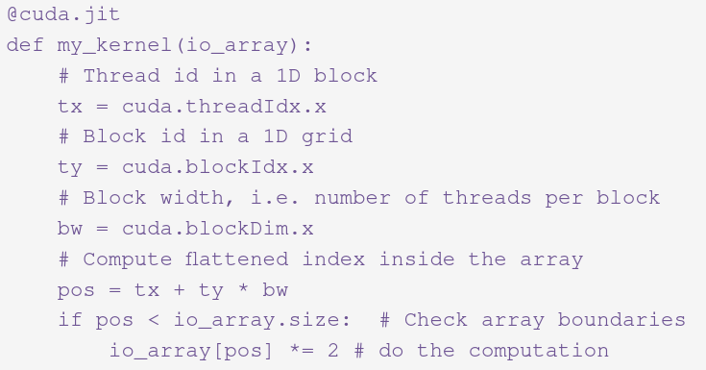
GPU Introduction
Numba can compile for NVIDIA GPUs!
Can use the @vectorize decorator
Just use target=‘cuda’
Numba cannot handle all Python functions on the GPU
Can make writing functions for the GPU easier
You can dive deep and make the function code look more like CUDA
Need to understand more about CUDA programming
https://numba.pydata.org/numba-doc/dev/cuda/kernels.html

Slide 45
Allowed Numba Functions
(WARNING: It’s not everything)
Allowed statements/functions:
if/elif/else
while and for loops
Basic math operators
Selected functions from the math and cmath modules
Tuples
int, float, complex, bool, None, tuple
http://numba.pydata.org/numba-doc/latest/cuda/cudapysupported.html

Slide 46
@Vectorize NV GPU Target Example
import numpy as np
from time import perf_counter
from numba import vectorize
@vectorize(['float32(float32, float32)'], target='cuda')
def Add(a, b):
return a + b
# end def
# Initialize arrays
N = 100000000
A = np.ones(N, dtype=np.float32)
B = np.ones(A.shape, dtype=A.dtype)
C = np.empty_like(A, dtype=A.dtype)
# Add arrays on CPU
start_time = perf_counter( )
C = Add(A, B)
stop_time = perf_counter( )
print(C)
print('')
print(' Elapsed wall clock time = %g seconds.' % (stop_time - start_time) )
print('')
1.3.1
Reminder of “targets” for vectorize
Target=‘cpu’ Single-threaded CPU
Target=‘parallel’ Multi-core CPU
Target=‘cuda’ NVIDIA GPU
This example targets the NVIDIA GPU
Simplest way to compile functions that run on the GPU
Everything stays as Numpy arrays or scalars
Python code stays the same (make sure you only have one return variable)

Slide 47
What happened?
Compiled a CUDA kernel when first used
Allocated GPU memory for the input(s) and the output (one return variable is allowed)
Also any intermediate variables
Copied the input data to the GPU
Executed the CUDA kernel with the correct kernel dimensions given the input sizes
Copied the results back from the GPU to the CPU
Returned the result as a NumPy object on the host

Slide 48
@cuda.jit
You might be tempted to use this decorator right away – be careful
You must explicitly write loops
Everything passed in/out of the function is a NumPy array – even scalars
Can still define local scalars in the function (e.g. loop counters)
A bit more work than @vectorize
Can simply use @cuda.jit or write CUDA kernels in Python
For today, we’ll just use @cuda.jit

Slide 49
@cuda.jit example
import numpy as np
from time import perf_counter
from numba import cuda
@cuda.jit
def Add(a, b, c):
max_length = len(a)
for i in range(0, max_length):
c[i] = a[i] + b[i]
# end for
# end def
# Initialize arrays
N = 100000
A = np.ones(N, dtype=np.float32)
B = np.ones(A.shape, dtype=A.dtype)
C = np.empty_like(A, dtype=A.dtype)
# Add arrays on GPU
start_time = perf_counter( )
Add(A, B, C)
stop_time = perf_counter( )
print(C)
print('')
print(' Elapsed wall clock time = %g seconds.' % (stop_time - start_time) )
print('')
1.3.2
Gets you closer to “CUDA” coding
More flexibility
Theoretically better performance
Some code changes are required
Everything needs to be a Numpy variable
Scalars are ndarrays of size 1
“Return” variables are part of function call (like C code)
Data is passed through the function (as often seen in C, Fortran codes)
Notes:
http://numba.pydata.org/numba-doc/dev/cuda/index.html

Slide 50
@Cuda.jit
@cuda.jit takes you closer to CUDA coding
More flexibility
Theoretically more performance
Can control kernel launch (grid, blocks, threads)
numba.cuda.threadIdx, numba.cuda.blockDim ...
Thread placement
Memory Management
Three types of GPU memory:
Global device memory (the large, relatively slow off-chip memory that’s connected to the GPU itself)
On-chip shared memory
Local memory
Can define atomic operations

Slide 51
@Cuda.jit CODE changes
To use the @cuda.jit decorator, a few code changes need to be made
All loops must be explicitly written (no vectorization)
All variables _passed_ to/from compiled function must be created by Numpy – even scalars
Scalars are Numpy arrays of length 1
Data is passed through call statement (like C code)
Do not create data in the compiled function
Create arrays on host, copy them to function, modify them, copy back to host

Slide 52
Numba summary to date
For CPUs:
@jit for non-element-by-element functions
Can target single CPU or multi-core
Python fallback
@vectorize for element-by-element operations
Don’t have to write loops! Element-by-element
Can target single CPU or multi-core
For GPUs:
@cuda.jit for non element-by-element operations
Takes more work
Explicitly have to move data and write loops
Everything is a NumPy array
@vectorize for element-by-element operations
Same as CPU but with different target (target=cuda)
Have to write a type signature for each data type

Slide 53
Compiling Ahead of Time

Slide 54
Compiling ahead of time
Benefits
Numba is usually thought of as Just-in-Time (JIT)
Impacts runtime due to compilation
How do we do Ahead-of-Time compiling (AOT)?
AOT compilation produces a compiled extension module which does not depend on Numba
You can distribute the module on machines which don’t have Numba installed (does require NumPy)
There is no compilation overhead at runtime (but see the @jit cache option)
No overhead of importing Numba
Notes:
http://numba.pydata.org/numba-doc/dev/user/pycc.html

Slide 55
Compiling ahead of time
Limitations
AOT compilation only allows for regular functions, not ufuncs
You must specify function signatures explicitly
Each exported function can have only one signature (but you can export several different signatures under different names)
AOT compilation produces generic code for your CPU’s architectural family (for example “x86-64”), while JIT compilation produces code optimized for your CPU model
Notes:
http://numba.pydata.org/numba-doc/dev/user/pycc.html

Slide 56
Compiling ahead of time
Process
http://numba.pydata.org/numba-doc/dev/user/pycc.html
Need to install build system, etc.
Not covered in this workshop
Notes:
http://numba.pydata.org/numba-doc/dev/user/pycc.html

Slide 57
Example of Porting Process
Serial -> Functions -> CPU -> GPU

Slide 58
Python porting lifecycle example
Example of taking serial Python code, porting to Python code with functions, to using Numba on CPUs, to using Numba on GPUs
Moved from plain Python code to @jit on CPUs, to @cuda.jit on GPU
@cuda.jit on GPU requires code changes
This is a very, very simplified version of the initialization portion of a Molecular Dynamics (MD) mini-app
It only uses loops – not details of computations in loops
Computations are contrived (i.e. not real)
Original application is GPL:
https://people.sc.fsu.edu/~jburkardt/py_src/md/md.html

Slide 59
Example – serial python
import numpy as np
from time import perf_counter
# main loop
start_time = perf_counter( )
d_num = 5000
p_num = 5000
pos = np.zeros( shape=(d_num, p_num), dtype=np.float32 )
accel = np.zeros( shape=(d_num, p_num), dtype=np.float32 )
for j in range(0, p_num):
for i in range(0, d_num):
pos[i,j] = 6.5
# end for i
for i in range(0, d_num):
accel[i,j] = 4.2*pos[i,j]
# end for
# end for j
stop_time = perf_counter( )
print(pos)
print(accel)
print('')
print(' Elapsed wall clock time = %g seconds.' % (stop_time - start_time) )
print('')
2
Serial Python code
Two nested loops (you can easily combine them, but for this sample code, we won’t)
Classic starting point for initial code development
Write the code serially to get the correct answers
Then worry about performance

Slide 60
Example – Python with Functions
import numpy as np
from time import perf_counter
def init(p_num, d_num):
pos = np.zeros( shape=(d_num, p_num), dtype=np.float32 )
accel = np.zeros( shape=(d_num, p_num), dtype=np.float32 )
for j in range(0, p_num):
for i in range(0, d_num):
pos[i,j] = 6.5
# end for i
for i in range(0, d_num):
accel[i,j] = 4.2*pos[i,j]
# end for i
# end for j
return pos, accel
# end def
# main
d_num = 5000
p_num = 5000
start_time = perf_counter( )
pos, accel = init(p_num, d_num)
stop_time = perf_counter( )
print(pos)
print(accel)
print('')
print(' Elapsed wall clock time = %g seconds.' % (stop_time - start_time) )
print('')
2.1
Move arithmetic intense code to function(s)
Isolates code – simpler main
Multiple arrays returned to main

Slide 61
Example – @jit – target Single CPU COre
import numpy as np
from time import perf_counter
from numba import jit
@jit
def init(p_num, d_num):
pos = np.zeros( shape=(d_num, p_num), dtype=np.float32 )
accel = np.zeros( shape=(d_num, p_num), dtype=np.float32 )
for j in range(0, p_num):
for i in range(0, d_num):
pos[i,j] = 6.5
# end for i
for i in range(0, d_num):
accel[i,j] = 4.2*pos[i,j]
# end for i
# end for j
return pos, accel
# end def
# main
d_num = 5000
p_num = 5000
start_time = perf_counter( )
pos, accel = init(p_num, d_num)
stop_time = perf_counter( )
print(pos)
print(accel)
print('')
print(' Elapsed wall clock time = %g seconds.' % (stop_time - start_time) )
print('')
2.2
@jit compiles for the CPU by default
Just put the desired decorator before the function. No other changes

Slide 62
Example – @jit – target Multi-COre
import numpy as np
from time import clock
from numba import jit
@jit(nopython=True, parallel=True)
def init(p_num, d_num):
pos = np.zeros( shape=(d_num, p_num), dtype=np.float32 )
accel = np.zeros( shape=(d_num, p_num), dtype=np.float32 )
for j in range(0, p_num):
for i in range(0, d_num):
pos[i,j] = 6.5
# end for i
for i in range(0, d_num):
accel[i,j] = 4.2*pos[i,j]
# end for i
# end for j
return pos, accel
# end def
# main
d_num = 5000
p_num = 5000
start_time = perf_counter( )
pos, accel = init(p_num, d_num)
stop_time = perf_counter( )
print(pos)
print(accel)
print('')
print(' Elapsed wall clock time = %g seconds.' % (stop_time - start_time) )
print('')
2.3
@jit compiles for multiple cores (all cores)
Just put the desired decorator before the function. No other changes

Slide 63
Using @vectorize
The decorator @vectorize is used for simple functions
Input and a single return
Need type signature(s) for each data type
Write in scalar notation
Must be element-by-element
Check by writing in scalar
For this particular code, we take the one function and break it into two functions to get one return per function
Each operates on an array

Slide 64
Example – @Vectorize Single Core
import numpy as np
from time import perf_counter
from numba import vectorize
@vectorize(['float32(float32)'])
def set_pos(pos):
return 6.5
# end def
@vectorize(['float32(float32, float32)'])
def set_accel(pos, accel):
return 4.2*pos
# end def
# main
d_num = 5000
p_num = 5000
pos = np.zeros( shape=(d_num, p_num), dtype=np.float32 )
accel = np.zeros( shape=(d_num, p_num), dtype=np.float32 )
start_time = perf_counter( )
pos = set_pos(pos)
accel = set_accel(pos,accel)
stop_time = perf_counter( )
print(pos)
print(accel)
print('')
print(' Elapsed wall clock time = %g seconds.' % (stop_time - start_time) )
print('')
2.4
Split larger function into two functions
Each function has a single return
Set the input definition for each function
Use default target

Slide 65
Example – @Vectorize parallel
import numpy as np
from time import perf_counter
from numba import vectorize
@vectorize(['float32(float32)'], target='parallel')
def set_pos(pos):
return 6.5
# end def
@vectorize(['float32(float32, float32)'], target='parallel')
def set_accel(pos, accel):
return 4.2*pos
# end def
# main
d_num = 5000
p_num = 5000
pos = np.zeros( shape=(d_num, p_num), dtype=np.float32 )
accel = np.zeros( shape=(d_num, p_num), dtype=np.float32 )
start_time = perf_counter( )
pos = set_pos(pos)
accel = set_accel(pos,accel)
stop_time = perf_counter( )
print(pos)
print(accel)
print('')
print(' Elapsed wall clock time = %g seconds.' % (stop_time - start_time) )
print('')
2.5
Specify target, “parallel”

Slide 66
Example – @Vectorize CUDA
import numpy as np
from time import perf_counter
from numba import vectorize
@vectorize(['float32(float32)'], target='cuda')
def set_pos(pos):
return 6.5
# end def
@vectorize(['float32(float32, float32)'], target='cuda')
def set_accel(pos, accel):
return 4.2*pos
# end def
# main
d_num = 5000
p_num = 5000
pos = np.zeros( shape=(d_num, p_num), dtype=np.float32 )
accel = np.zeros( shape=(d_num, p_num), dtype=np.float32 )
start_time = perf_counter( )
pos = set_pos(pos)
accel = set_accel(pos,accel)
stop_time = perf_counter( )
print(pos)
print(accel)
print('')
print(' Elapsed wall clock time = %g seconds.' % (stop_time - start_time) )
print('')
2.6
Switch target to NVIDIA GPU!

Slide 67
Example – @cuda.jit
import numpy as np
from time import perf_counter
from numba import cuda
@cuda.jit
def init(p_num, d_num, pos, accel):
for j in range(0, p_num[0]):
for i in range(0, d_num[0]):
pos[i,j] = 6.5
# end for i
for i in range(0, d_num[0]):
accel[i,j] = 4.2*pos[i,j]
# end for i
# end for j
# end def
# main loop
d_num = np.zeros(1, dtype=int)
p_num = np.zeros(1, dtype=int)
d_num[0] = 5000
p_num[0] = 5000
pos = np.zeros( shape=(d_num[0], p_num[0]), dtype=np.float32 )
accel = np.zeros( shape=(d_num[0], p_num[0]), dtype=np.float32 )
start_time = perf_counter( )
d_p_num = cuda.to_device(p_num)
d_d_num = cuda.to_device(d_num)
d_pos = cuda.to_device(pos)
d_accel = cuda.to_device(accel)
init(p_num, d_num, pos, accel)
stop_time = perf_counter( )
print(pos)
print(accel)
print('')
print(' Elapsed wall clock time = %g seconds.' % (stop_time - start_time) )
print('')
2.7
@cuda.jit compiles for NVIDIA GPU by default
Function cannot “return” data
Have to move data to/from GPU explicitly
Like C code
Allows us to write a single function
Scalars are Numpy array of size 1
Have to refer to scalar as the [0] element of the array

Slide 68
Functions Calling Functions

Slide 69
Routines calling Routines
Let’s go a little further in our use of Numba and compile multiple functions that call each other
Better than putting everything in one giant function (can help compiler)
Start with CPU (single pool of memory, don’t have to move data Host<->Device)
Move to GPU
The code is a slight modification of the previous code @vectorize CPU code
Add new function
Two functions now (additional array)

Slide 70
Plain Python
Routines calling Routines
import numpy as np
from time import perf_counter
from numba import jit
def init_pos_accel(p_num, d_num):
pos = np.zeros( shape=(d_num, p_num), dtype=np.float32 )
accel = np.zeros( shape=(d_num, p_num), dtype=np.float32 )
for j in range(0, p_num):
for i in range(0, d_num):
pos[i,j] = 6.5
# end for i
for i in range(0, d_num):
accel[i,j] = 4.2*pos[i,j]
# end for i
# end for j
vel = init_vel(p_num, d_num, pos, accel)
return pos, accel, vel
# end init
def init_vel(p_num, d_num, pos, accel):
vel = np.zeros( shape=(d_num, p_num), dtype=np.float32 )
for j in range(0, p_num):
for i in range(0, d_num):
vel[i,j] = pos[i,i] + accel[i,j] * 0.1*pos[i,j]
# end for i
# end for j
return vel
# end def
# main
d_num = 5000
p_num = 5000
start_time = perf_counter( )
pos, accel, vel = init_pos_accel(p_num, d_num)
stop_time = perf_counter( )
print(pos)
print(vel)
print(accel)
print('')
print(' Elapsed wall clock time = %g seconds.' % (stop_time - start_time) )
print('')
3
One routine calls another
init_pos_accel() calls init_vel()

Slide 71
CPU Compile both Routines
Routines calling Routines
import numpy as np
from time import perf_counter
from numba import jit
@jit
def init_pos_accel(p_num, d_num):
pos = np.zeros( shape=(d_num, p_num), dtype=np.float32 )
accel = np.zeros( shape=(d_num, p_num), dtype=np.float32 )
for j in range(0, p_num):
for i in range(0, d_num):
pos[i,j] = 6.5
# end for i
for i in range(0, d_num):
accel[i,j] = 4.2*pos[i,j]
# end for i
# end for j
vel = init_vel(p_num, d_num, pos, accel)
return pos, accel, vel
# end def
@jit
def init_vel(p_num, d_num, pos, accel):
vel = np.zeros( shape=(d_num, p_num), dtype=np.float32 )
for j in range(0, p_num):
for i in range(0, d_num):
vel[i,j] = pos[i,i] + accel[i,j] * 0.1*pos[i,j]
# end for i
# end for j
return vel
# end def
# main
d_num = 5000
p_num = 5000
start_time = perf_counter( )
pos, accel, vel = init_pos_accel(p_num, d_num)
stop_time = perf_counter( )
print(pos)
print(accel)
print(vel)
print('')
print(' Elapsed wall clock time = %g seconds.' % (stop_time - start_time) )
print('')
3.1
Much faster performance
For a CPU, you need to specifically compile routines for which you want better performance
Try targeting multi-core CPU (3.2)

Slide 72
@cuda.jit – multiple Routines
Device routines
3.3
import numpy as np
from time import perf_counter
from numba import cuda
@cuda.jit
def init_all(p_num, d_num, pos, accel, vel):
for j in range(0, p_num[0]):
for i in range(0, d_num[0]):
pos[i,j] = 6.5
# end for i
for i in range(0, d_num[0]):
accel[i,j] = 4.2*pos[i,j]
# end for i
# end for j
init_vel(p_num, d_num, pos, accel, vel)
# end def
@cuda.jit(device=True)
def init_vel(p_num, d_num, pos, accel, vel):
for j in range(0, p_num[0]):
for i in range(0, d_num[0]):
vel[i,j] = pos[i,i] + accel[i,j] * 0.1*pos[i,j]
# end for i
# end for j
# end def
# main loop
d_num = np.zeros(1, dtype=int)
p_num = np.zeros(1, dtype=int)
d_num[0] = 5000
p_num[0] = 5000
pos = np.zeros( shape=(d_num[0], p_num[0]), dtype=np.float32 )
accel = np.zeros( shape=(d_num[0], p_num[0]), dtype=np.float32 )
vel = np.zeros( shape=(d_num[0], p_num[0]), dtype=np.float32 )
start_time = perf_counter( )
d_p_num = cuda.to_device(p_num)
d_d_num = cuda.to_device(d_num)
d_pos = cuda.to_device(pos)
d_accel = cuda.to_device(accel)
d_vel = cuda.to_device(vel)
init_all(p_num, d_num, pos, accel, vel)
stop_time = perf_counter( )
print(pos)
print(vel)
print(accel)
print('')
print(' Elapsed wall clock time = %g seconds.' % (stop_time - start_time) )
print('')
Device=True :: This GPU function will be called by another GPU function!
Notes:
To allow one GPU function to call another GPU function, we could just stuff everything into a single function.
Not very practical (compiler may produce slower code)
@cuda.jit has an option that tells the compiler that the data is already on the device (no need to pass data around)

Slide 73
Numba Summary
Numba is great for improving performance (of arithmetically intensive code)
Even for a single core, you can get lots of speedup. You still get to write in Python!!!
You can even target multiple CPU cores to maybe get more speed
You can target NVIDIA GPUs very easily
You can do it simply using @vectorize
You can take advantage of CUDA features, but it is still mostly Python!
@cuda.jit is very powerful but you can use it with simple Python code
Numba interoperates with other Python-GPU tools!

Slide 74
Best Practices
There may be times when your Numba compiled function will not improve performance
Ask yourself – why?
Example:
Don’t try to put an already compiled function into a Numba compiled function
Example – NumPy “convolve” function. It is already compiled for CPUs.
What do we do for GPUs?
Write your own convolution function ☺
Or find a library that already has this function available

Slide 75
TL;DR - OVERALL Python-GPU CODING recommendations
Move computationally intensive sections of code to functions
Use @jit on CPUs (Numba)
Start with single core then move to multi-core
Switch to @vectorize (Numba)
Port to GPUs (@vectorize and @cuda.jit)
May need to optimize data movement
Investigate custom kernels when you need more performance (or have more time)
Good topic to bring up this afternoon at office hours!

Slide 76
CUPY

Slide 77
Generalities
Scientific/Engineering Applications
Good: Python has a huge number of libraries
Bad: Python has a huge number of libraries
Many scientific/engineering/data science codes are built using:
NumPy
SciPy
Scikit-learn
Pandas
Many others…
A great deal of focus has been on Numpy

Slide 78
Numpy
NumPy is probably the most popular library/tool outside of the core Python
One of the first “big” projects for Python
Many years of development
Numeric focus
Highly tuned (for CPUs)
What about GPUs?

Slide 79
CuPY
https://github.com/cupy/cupy
NumPy-like API accelerated with CUDA
Implements a subset of NumPy interface, but it’s very close to being complete
Adding some SciPy routines!
Originally used by Chainer (DL framework popular in Japan)
Calling sequence is like NumPy
>> import numpy as np
>> import cupy as cp
>> x_cpu = np.array([1, 2, 3])
>> l2_cpu = np.linalg.norm(x_cpu)
>> x_gpu = cp.array([1 ,2 ,3])
>> l2_gpu = cp.linalg.norm(x_gpu)
Very Pythonic and very easy to use!

Slide 80
CUPY
Installation Notes
“pip install cupy”
Last time I checked it was a really old version
“conda install cupy”
On Windows, a bit on the older side (as of this writing – 6 months)
Linux has more up to date versions

Slide 81
CuPy FEATURES - 1
NumPy uses a class: numpy.ndarray
Cupy has a class: cupy.ndarray (almost identical – extra information)
Features:
NumPy-like indexing
Most of Advanced indexing
Data Types (dtypes):
bool_, int8, int16, int32, int64, uint8, uint16, uint32, uint64, float16, float32, float64, complex64, complex128
Most of the array creation and manipulation routines
All operators with broadcasting
All universal functions for elementwise operations (add(), subtrace(), exp(), log(), sin()…)

Slide 82
CuPy FEATURES - 2
Linear algebra functions:
dot, inner, outer, matmul, tensordot, kron, etc.
Linalg:
cholesky, QR, SVD, eigh, eigvalsh, deter, norm, matrix_rank, trace, solve, tensorsolve, inv, pinv
Transpose, other matrix functions (e.g trig, comparisons, logical), saves to file, random functions, distributions
Multi-dimensional matrices – indexing routines
Matrix arithmetic
Reduction along axes (sum, max, argmax, etc.)
FFT (forward and inverse)
Uses NV libraries (cuFFT, cuBLAS, etc.)

Slide 83
CuPy FEATURES - 3
Mathematical Functions:
Many standard functions: cos, tan, sin, floor, ceil, sum, prod, log, multiple, maximum
Random functions:
rand, random, ranf, sample, random.seed, shuffle
Sort, Search, Count:
sort, argmax, partition, nonzero, where
Stats:
mean, var, std, bincount, amin, amax, sum, histograms (binsort)
Sparse Matrix class:
Similar functions to full matrix

Slide 84
CuPy FEATURES - 4
NumPy - CuPy CUDA Code Support
Move data to/from GPU, device management, memory management, debugging, streams, events, hooks for profiling, testing modules
Can do custom kernels
User-defined elementwise CUDA kernels
User-defined reduction CUDA kernels
Documentation is excellent

Slide 85
CuPy New-ish FEATURES
Started to write SciPy functions
cupyx
Examples:
cupyx.scipy.fft.X() – FFT
cupyx.scipy.fftpack.X() – Legacy FFT
cupyx.scipy.linalg.lu_factor()
cupyx.scipy.linalg.lu_solve()
cupyx.scipy.linalg.solve.triangular()

Slide 86
CUPY Simple example
SVD
import cupy as cp
A = cp.random.uniform(low=-1., high=1., size=(64, 64)).astype(cp.float32)
u, s, v = cp.linalg.svd(A)
4.1
u, s, v are still on GPU
Notes:
Everything created on device. Results from svd are still on device after the computation!

Slide 87
CUPY Simple example
SVD – 2 (copy data to/from CPU)
import cupy as cp
import numpy as np
A_cpu = np.random.uniform(low=-1., high=1., size=(64, 64)).astype(np.float32)
A_gpu = cp.asarray(A_cpu)
u_gpu, s_gpu, v_gpu = cp.linalg.svd(A_gpu)
print "type(u_gpu) = ",type(u_gpu)
u_cpu = cp.asnumpy(u_gpu)
print "type(u_cpu) = ",type(u_cpu)
[laytonjb@home4 CUPY]$ python svd2.py
type(u_gpu) = <type 'cupy.core.core.ndarray'>
type(u_cpu) = <type 'numpy.ndarray'
4.2
Copy A_cpu to GPU. Becomes CuPy object
Copy u_gpu to Host. Becomes Numpy object
Notes:
Good idea to use data location in variable name

Slide 88
CUPY Simple EXAMPLE
Matrix Multiplication on GPU
import math
import cupy as cp
A = cp.random.uniform(low=-1., high=1., size=(64,64)).astype(cp.float32)
B = cp.random.uniform(low=-1., high=1., size=(64,64)).astype(cp.float32)
C = cp.matmul(A,B)
Notes:
Note: Arrays A and B are created on the device (no data movement)
Result matrix, C, is on the device.
Matmul doesn’t care about data type (try different data types as an exercise)
All of this is already coded into the CuPy module

Slide 89
MATRIX MULTIPLICATION
4.3
The example in the first cell of the Jupyter notebook creates the two input arrays on either the CPU or the GPU (uses cupy method, asnumpy() )
Then the multiplication is performed (and timed)
Try varying the “size” variable to see where the GPU is faster than the CPU.
Second cell copies the data from the CPU to the GPU using a method as array()
The timings include the time to transfer the data from the CPU to the GPU (and back)
Try varying the size of the problem to where the CPU and GPU times are about the same
How does this compare to the previous cell where data was created on the GPU?
4.4

Slide 90
Observations
Notice you must explicitly copy data from host to device or from device to host
Remember that this can limit performance
“What is computed on the GPU, stays on the GPU”
Can create data on GPU
After computation, data remains on device
You can copy it back to host
Or you can perform further computations using those results
Almost anything that is coded in NumPy, can be coded in CuPy
Notes:
Other example: https://chainer-colab-notebook.readthedocs.io/ja/latest/notebook/example/cupy/prml/ch01_Introduction_ipynb.html

Slide 91
Advantages of CUPY
Matrix Manipulation
Leaving data on GPU allows easier coding for equations such as,
Q = XA^{T} + AX + DWD^{T}
C₁ = (I – B_{p}B_{p}⁺) Q_{p} (I – B_{p}B_{p}⁺)
Allows equations to be broken into pieces for easier coding
Can copy back intermediate results as needed

Slide 92
CuPy - Differences with Numpy
Cast behavior from float to integer
Some casting behaviors from float to integer are not defined in C++ specification
The casting from a negative float to unsigned integer and infinity to integer is one of such examples
Random methods support dtype argument
Behavior with out-of-bounds indices
Behavior with duplicate values in indices
Reduction methods return zero-dimensional array, while numpy returns scalars
https://docs-cupy.chainer.org/en/stable/reference/difference.html

Slide 93
TL;DR - OVERALL Python-GPU CODING recommendations
Move computationally intensive sections of code to functions
Use @jit on CPUs (Numba)
Start with single core then move to multi-core
Switch to @vectorize (Numba)
Port to GPUs (@vectorize and @cuda.jit)
May need to optimize data movement
Use CuPy for common computations
Consider custom kernels when you need more performance (or have more time)

Slide 94
GPU Programming questions?
kkeipert@nvidia.com
Python GPU Programming
CUDA C/C++/Fortran
GPU Porting Strategy
Performance Profiling and Developer Tools

Slide 95
CUPY and DASK

Slide 96
Lots of Resources
CuPy runs on a single GPU today
Today’s systems have many CPU cores and GPUs
And we have lots of systems
Why can’t we use all of these to solve really huge problems or solve other problems much faster?
This is where Dask comes in

Slide 97
What is Dask?
Dask (https://dask.org/) is a tool for advanced parallelism in Python
It allows you to code different tasks to solve a problem and distribute them to different resources within the node or other nodes
It has been developed in coordination with NumPy, Pandas, and Scikit-learn, among others
Example: you can take a NumPy function, such as an SVD, parallelize it with multiple tasks, and spread these tasks across other nodes
The number of nodes can grow or shrink based on the computational needs
Bad analogy but think of it as a “dynamic MPI” for Python (it’s more than an MPI)

Slide 98
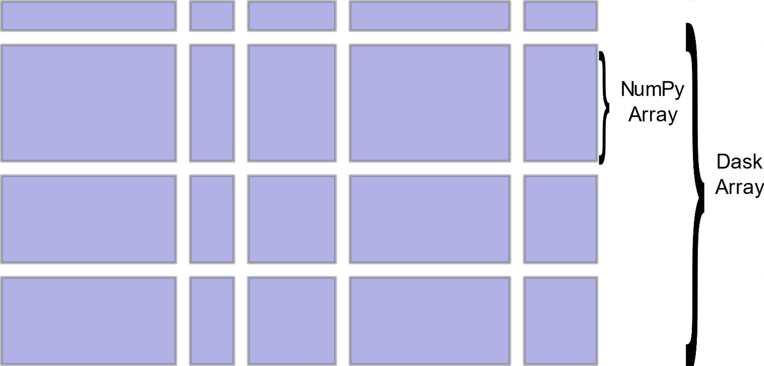
What is Dask?
Arrays
Dask “arrays” coordinate many NumPy arrays arranged into a grid
The arrays may live on disk or on other machines
Some parts of NumPy have been implemented in Dask
Namely, parts of linalg
SVD, QR, Least square, solve, and solve_triangular have been implemented

Slide 99
Using CUPY with Dask
SVD has been implemented in Dask
CuPy is a GPU implementation of NumPy – it interoperates with Dask!
https://blog.dask.org/2019/03/18/dask-nep18

Slide 100
Start client
from dask.distributed import Client
client = Client()
5.1
The Client is the primary entry point for users of dask.distributed
After we setup a cluster, we initialize a Client by pointing it to the address of a Dask Scheduler
In this example, it is the single node (your laptop)
https://distributed.dask.org/en/latest/client.html

Slide 101
SVD starting point
import numpy as np
x = np.random.random((5000, 1000))
u, s, v = np.linalg.svd(x)
5.2
Python code to compute the SVD decomposition

Slide 102
Use Dask Array
import numpy as np
import dask.array as da
x = np.random.random((5000, 1000))
d = da.from_array(x, chunks=(1000, 1000))
u, s, v = np.linalg.svd(d)
5.3
“d” is the dask array broken into chunks of (1000, 1000)
The decomposition is performed on “d” and not “x” (distributed array)
The SVD routine is “dask-aware”
A Task Graph is created by these commands (lazy evaluation)
The next step is to compute the decomposition and bring the distributed pieces back to the starting node

Slide 103
Perform SVD
s_local = s.compute()
u_local = u.compute()
v_local = v.compute()
print("First singular value = ",s_local[0])
print("shape(u) = ", u.shape)
print("shape(v) = ", v.shape)
5.4
The “compute” method actually performs the distributed computations and reassembles the results locally

Slide 104
Use Dask Array on GPU
import numpy as np
import cupy
import dask.array as da
x = cupy.random.random((5000, 1000))
d = da.from_array(x, chunks=(1000, 1000))
u, s, v = np.linalg.svd(d)
s_local = s.compute()
u_local = u.compute()
v_local = v.compute()
print("First singular value = ",s_local[0])
print("shape(u) = ", u.shape)
print("shape(v) = ", v.shape)
Want to replace NumPy array with CuPy array and compute (no additional or special changes)
This is NOT the Dask array
Let NumPy do its magic via __array_function__ protocol
Dispatch the appropriate CuPy linear algebra operations under the hood
5.5, 5.5.1

Slide 105
Stop the Client
from dask.distributed import Client
client.shutdown()
Don’t forget to stop the client!

Slide 106
Thank you!
kkeipert@nvidia.com

